Slide 1





AD3X.
HACKATHON. AI.
BLOCKCHAIN. WEB3.
ADTECH.

Slide 2






REVOLVERS
ANUJ JADHAV
BHAVYA BHOSALE
LIKHITH RAJ V
ABHAY SURYA L R
anujjadhav4122@gmail.com
bhavyabhosale1815@gmail.com
likhithsubbu@gmail.com
abhaysuryalr@gmail.com
PROBLEM STATEMENT
Building an LLM Chatbot for Custom Input Data

Slide 3

SOLUTION OVERVIEW
OVERVIEW
Our project aims to build an LLM chatbot that leverages open-source tools to provide scalable and customized customer support, operating on Telegram and a webpage, using data from Alkimi for accurate information retrieval and real-time interaction.
Integrating RAG with custom input data, enabling highly accurate and scalable customer support access while leveraging open-source tools to maximum flexibility and cost-efficiency.
UNIQUE SELLING POINTS
Frontend – Streamlit
Backend – Python
LangChain, PyPDF2, BeautifulSoup, GoogleGemma (Open Source), Selenium, FAISS (vector database)
TECHNOLOGY STACK
CHALLENGES ENCOUNTERED
1. Processing the image inside the pdf into text format
Approach – Used EasyOCR and Pymupdf which helped us in extracting the text from images
2. Scrapping the webpage of www.alkimi.org due to animations
Approach – Overcame by using a call back function using BeautifulSoup
3. Creating a Chatbot on Telegram
Approach – Used python-telegram-bot. With the help of event and message handlers, the bot was able to respond as per the query by the user.

Slide 4
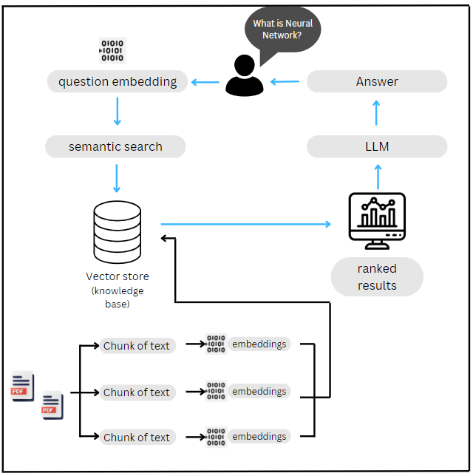
HOW IT WORKS?
1. PDF & URL loading: The app reads multiple pdf documents and extracts their content.
2. Text Chunking: The extracted text is divided into smaller chunks.
3. Language Model: The application uses language model to generate vector embedding.
4. Similarity matching: When you ask question, app compares the text chunks and identifies most semantically similar ones.
5. Response Generation: The selected chunks are passed to language model, which generates a response based on relevant context.

Slide 5
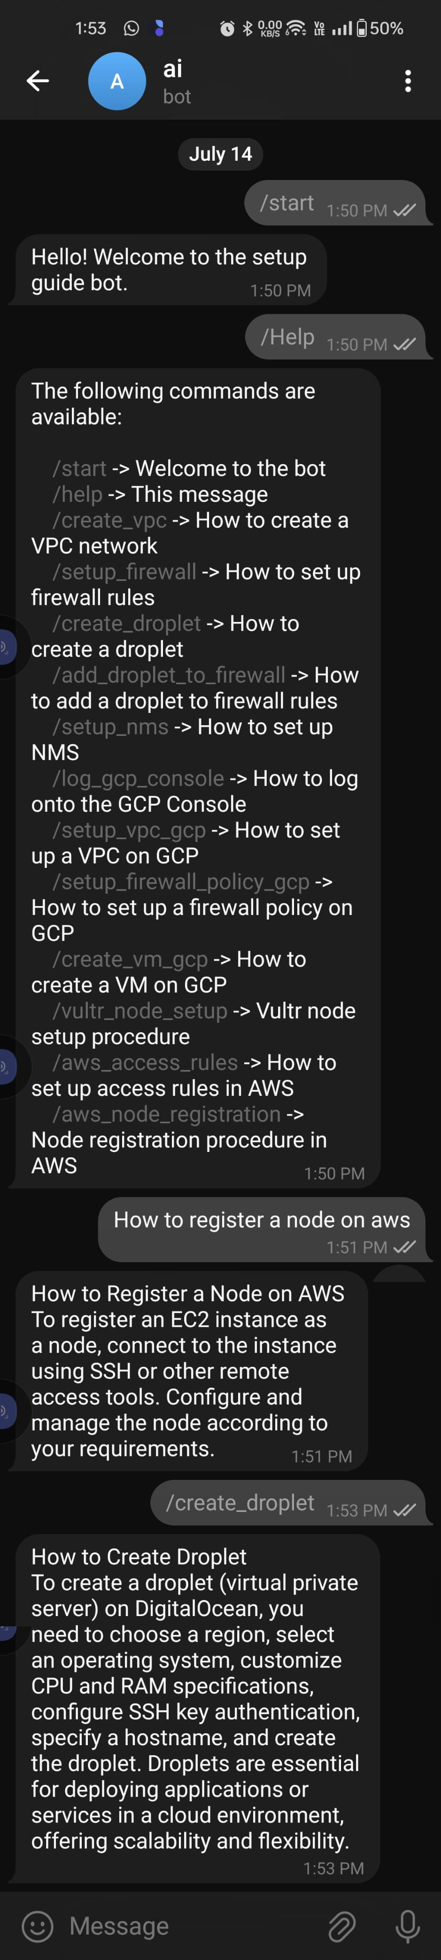
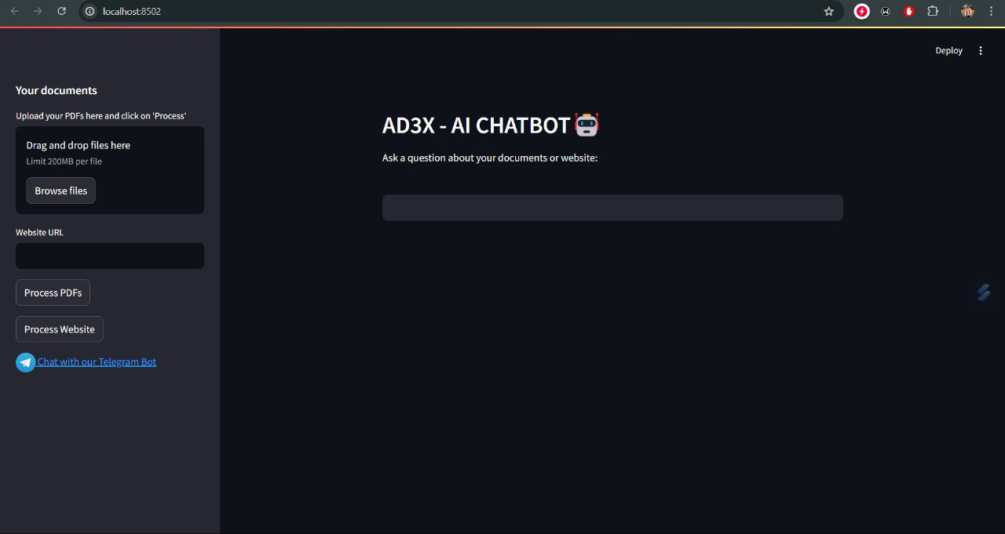
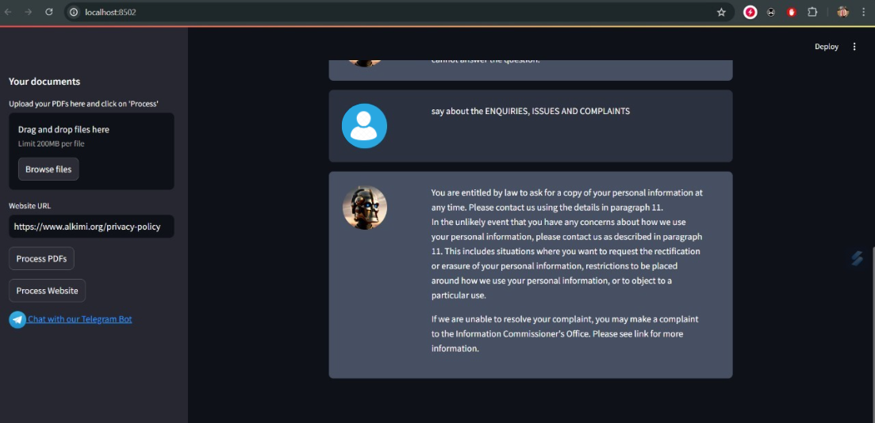
LIVE DEMO
Telegram Bot

Slide 6
CONCLUSION
In summary, our project introduces an advanced LLM chatbot for scalable customer support, integrating RAG and diverse data sources with open-source tools for accuracy and cost-efficiency. Operating seamlessly on webpages and Telegram, it offers a user-friendly experience. Key takeaways include effective data handling, leveraging open-source advantages, and the impact of advanced model integration on customer service.
We welcome feedback and collaboration opportunities.

